Slide 1
Support Vector Machine
支持向量機
Speaker ：Yao-Min Huang
Date ：2004/11/17

Slide 2
Outline
Linear Learning Machines
Kernel-Induced Feature
Optimization Theory
SVM Concept
Hyperplane Classifiers
Optimal Margin Support Vector Classifiers
ν-Soft Margin Support Vector Classifiers
Implement Techniques
Implementation of ν-SV Classifiers
Tools
Conclusion

Slide 3
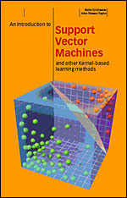
Linear Learning Machines
Ref：AN INTRODUCTION TO SUPPORT VECTOR MACHINES Chap2

Slide 4
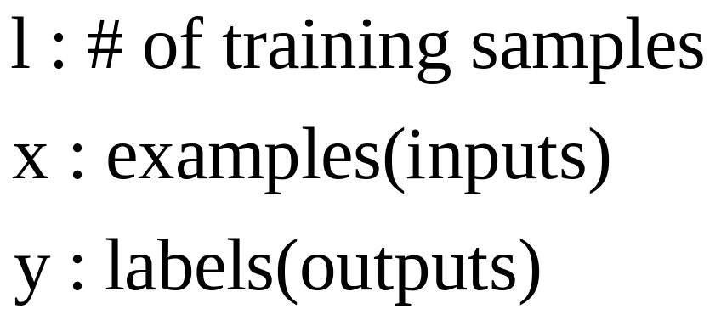
Introduction
In supervised learning, the learning machine is given a training set of inputs with associated output values

Slide 5
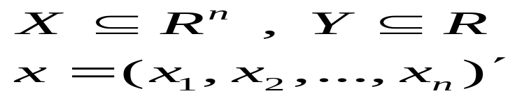
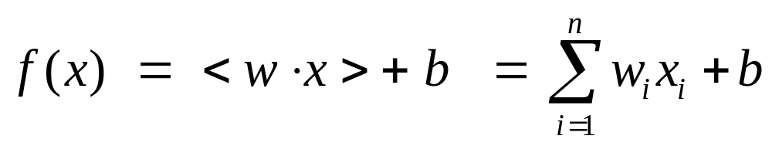
Introduction
A training set S is said to be trivial if all labels are equal
Usually
Binary classification
  Input x = (x1, x2, …, xn)’
  f(x) >= 0 : assigned to positive class (assign x to +1)
  Otherwise negative class (assign x to -1)

Slide 6
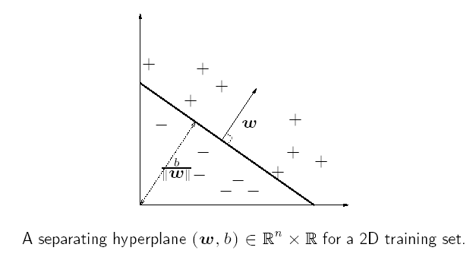
Linear Classification

Slide 7
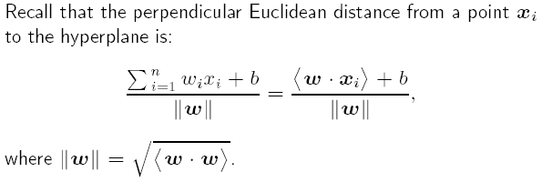
Linear Classification
The hyperplane (超平面) is the dark line.
w defines a direction perpendicular to the hyperplane
b moves the hyperplane parallel to itself (# of free parameter is n+1)

Slide 8
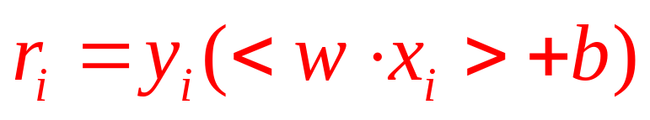
Linear Classification
Def：Functional margin
  γ > 0 implies correct classification
  The geometric margin is the perpendicular Euclidean distance of the point to the hyperplane
  The margin of a training set S is the maximum geometric margin over all hyperplanes.
  Try to find hyperplane (wopt, bopt) where the margin is largest

Slide 9
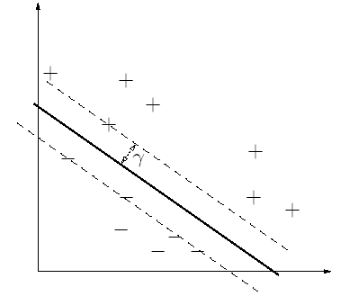
Linear Classification

Slide 10
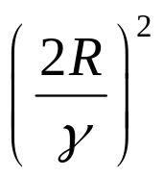
Rosenblatt’s Perceptron
By Frank Rosenblatt in 1956
on-line and mistake driven ( it only adapt the weight when a classification is made )
Starts with an initial connection weight vector w=0
k at most (k is total mistakes)
Require the data to be linearly separable

Slide 11
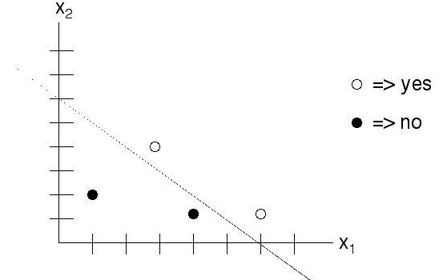
Rosenblatt’s Perceptron
Linearly separable

Slide 12
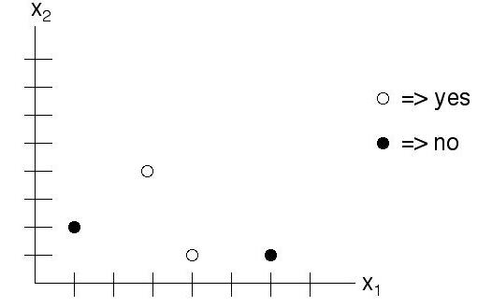
Rosenblatt’s Perceptron
Non-separable

Slide 13
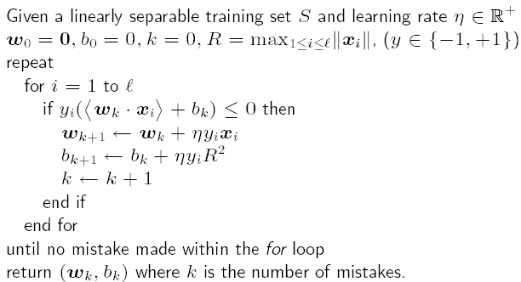
Rosenblatt’s Perceptron

Slide 14
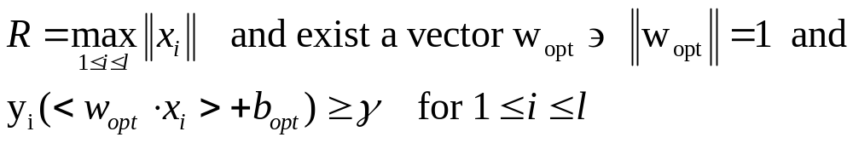
Rosenblatt’s Perceptron
Theorem ： Novikoff
  Prove that Rosenblatt’s algorithm will converge
  Then k <= (k is the number of mistakes)
  Proof (Skip)

Slide 15
Rosenblatt’s Perceptron
Def ：slack variable ξ
  Fix γ > 0 we can define the margin slack variable
  If ξ > γ , xi is misclassified by (w, b)
  Figure (Next page)
    Two misclassified points
    Other points have their slack variable equal to zero, since they have a positive margin more than γ

Slide 16
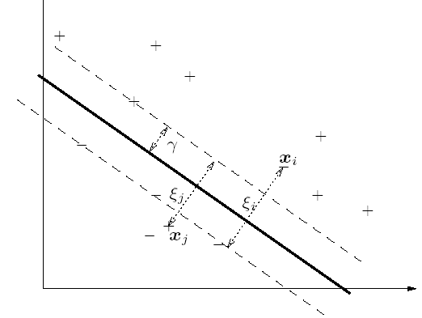
Rosenblatt’s Perceptron

Slide 17
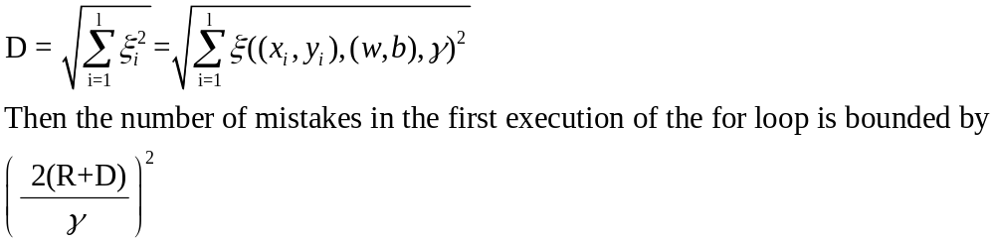
Rosenblatt’s Perceptron
Theorem： Freund and Schapire
S : nontrivial training set
|xi| <= R
(w, b) be any hyperplane with |w| = 1, γ >0

Slide 18
Rosenblatt’s Perceptron
Freund and Schapire
  Can only apply for the first iteration
  D can be defined by any hyperplane, the data are not necessarily linear separable
  Finding the smallest # of mistakes is NP-complete

Slide 19
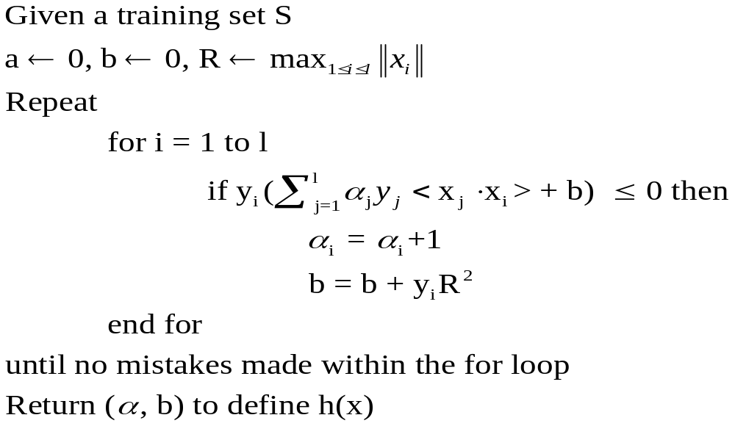
Rosenblatt’s Perceptron
Algorithm in dual form (Use Lagrange Multiplier and KKT coditions ➔ derivate the w ➔ get w=??

Slide 20
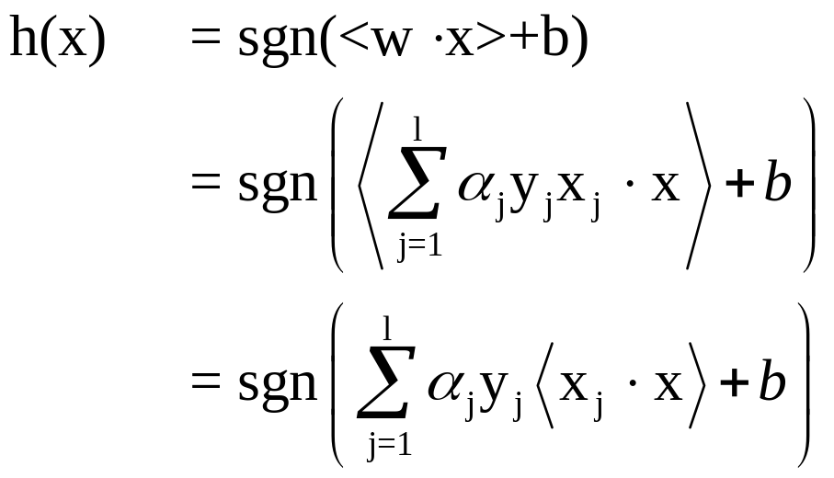
Rosenblatt’s Perceptron
example i with few/many mistakes has a small/large α_{i}
α_{I} can be regarded as the information content of x_{i}
The points that are harder to learn have larger α_{i} can be used to rank the data according to their information content.

Slide 21
Kernel-Induced Feature
Ref：AN INTRODUCTION TO SUPPORT VECTOR MACHINES Chap3
The section 5 of the paper “A tutorial on nu-Support Vector Machines”

Slide 22
Overview
Non-Linear Classifiers
  One solution: Multiple layers of threshold linear function ➔ multi-layer neural network
  (problems: local minima; many parameters;
  heuristics needed to train …etc)
  Other solution: project the data into a high dimensional feature space to increase the computational power of the linear learning machine.

Slide 23

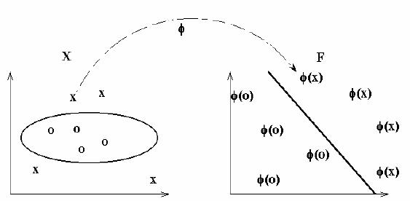
Overview

Slide 24
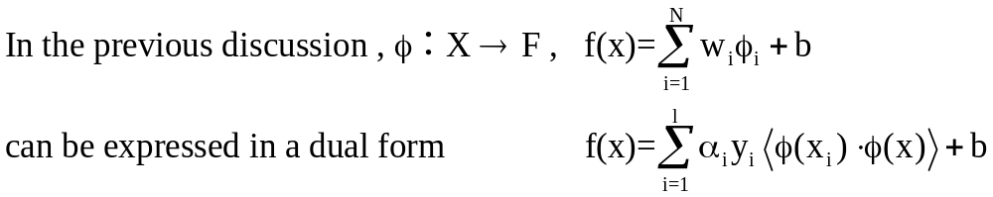
Kernel Function
In order to learn non-linear relations with a linear machine, we need to select a set of non-linear features and to rewrite the data in the new representation.
  First ：a fixed non-linear mapping transforms the data into a feature space F
  Second：classify them in the feature space
If we have a way of computing the inner product in the feature space directly as a function of the original input points, it becomes possible to merge the two steps needed to build a non-linear learning machine.
We call such a direct computation method a kernel function,

Slide 25
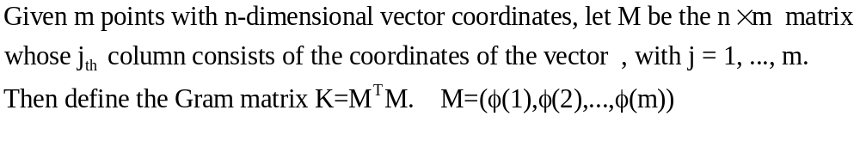
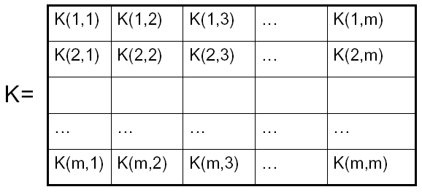
The Gram (Kernel) Matrix
Gram matrix (also called the kernel matrix)
  Contains all necessary information for learning algorithm.

Slide 26
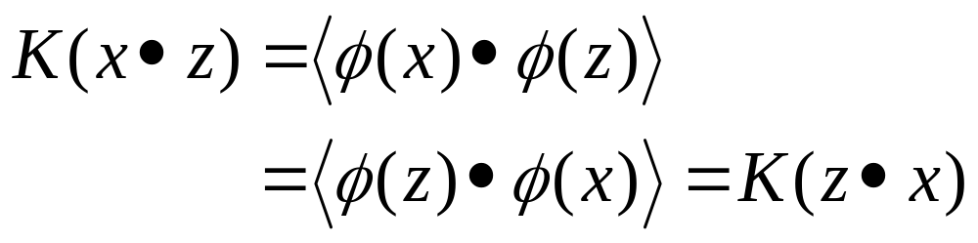
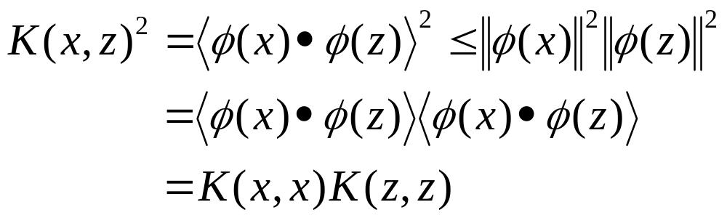
Making Kernels
The mapping function must be symmetric,
and satisfy the inequalities that follow from the Cauchy-Schwarz inequality.

Slide 27
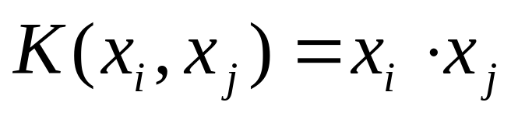
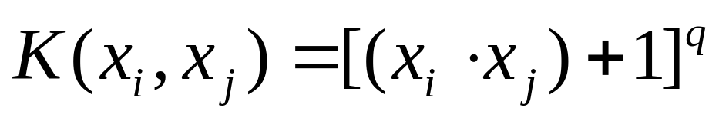
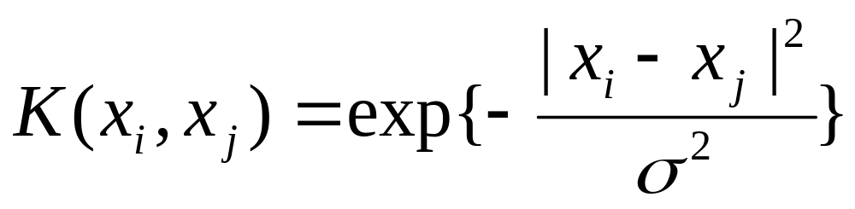
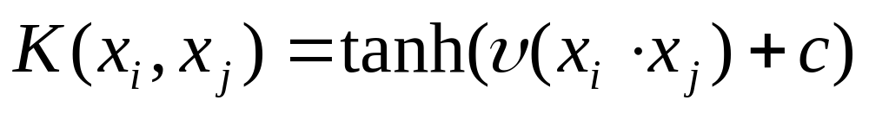
Popular Kernel function
線性內核
半徑式函數(Radial Basis Function)內核
多項式內核
Sigmoid 內核

Slide 28
Optimization Theory
Ref：AN INTRODUCTION TO SUPPORT VECTOR MACHINES Chap5
http://www.chass.utoronto.ca/~osborne/MathTutorial/

Slide 29
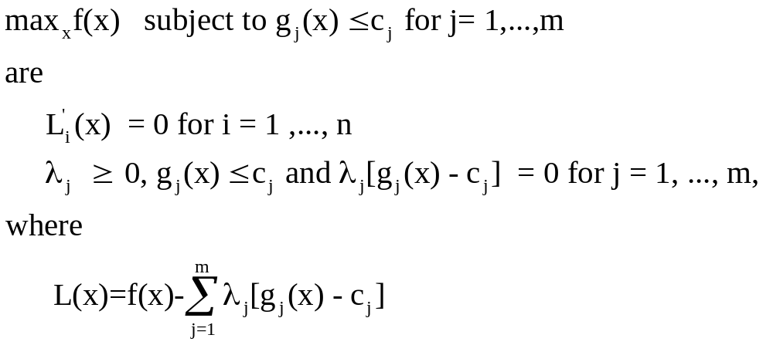
Optimization Theory
Definition
  The Kuhn-Tucker conditions for the problem
L(x) : the Lagrangian (Lagrange, 1788)
So called the complementarity condition

Slide 30
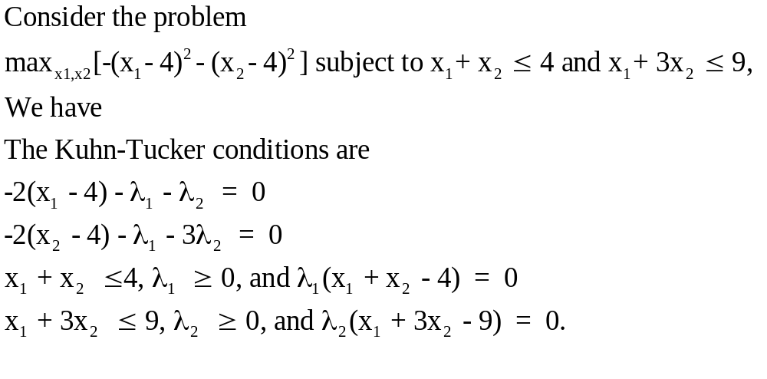
Optimization Theory
Ex

Slide 31
SVM Concept
Ref：The section 2 of the paper “A tutorial on nu-Support Vector Machines”

Slide 32
The history of SVM
SVM是一種基于統計學習理論的模式識別方法，它是由Boser,Guyon,Vapnik在COLT-92上首次提出，從此迅速的發展起來，現下已經在許多領域（生物訊息學、文本和手寫識別、分類…等）都取得了成功的應用
COLT(Computational Learning Theory)

Slide 33
SVM Concept
目標︰找到一個超平面(Hyperplane)，使得它能夠儘可能多的將兩類數據點正確的分開，同時使分開的兩類數據點距離分類面最遠。
解決方法︰構造一個在約束條件下的最佳化問題，具體的說是一個受限二次規劃問題(constrained quadratic programming),求解該問題，得到分類器。

Slide 34
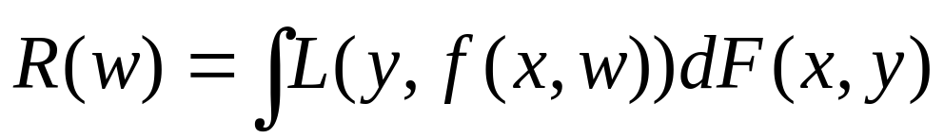
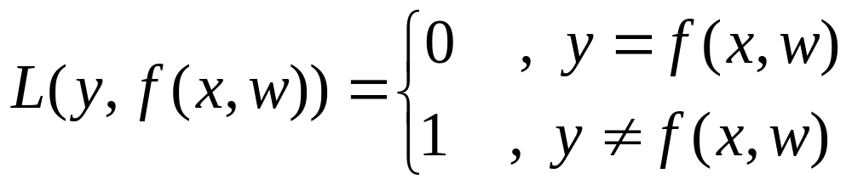
模式識別問題的一般描述
已知︰m個觀測樣本，(x₁,y₁), (x₂,y₂)…… (x_{m},y_{m})
求︰最佳函數y’= f(x,w)
滿足條件︰期望風險最小
損失函數

Slide 35
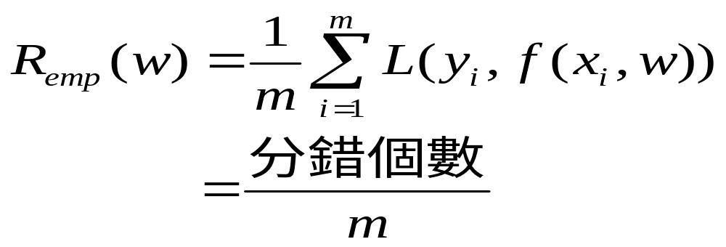
期望風險R(w)要倚賴聯合機率F(x,y)的資訊，所以實際問題中無法計算。
一般用經驗風險Remp(w)代替期望風險R(w)

Slide 36
一般模式識別方法的問題
經驗風險最小不等于期望風險最小，不能保證分類器的預測能力.
經驗風險只有在樣本數無窮大趨近于期望風險，需要非常多的樣本才能保證分類器的效能。
需要找到經驗風險最小和推展能力最大的平衡點。

Slide 37
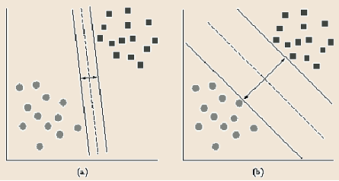
最佳分類面
簡單情況︰
在線性可分割的情況下的最優分類面（Margine最大）

Slide 38
SVM問題的數學表示
已知︰m個觀測樣本，(x₁,y₁), (x₂,y₂)…… (x_{m},y_{m})
目標︰最佳分類面 wx+b=0
滿足條件︰該分類面
經驗風險最小（錯分最少）
推展能力最大（空白最大）

Slide 39
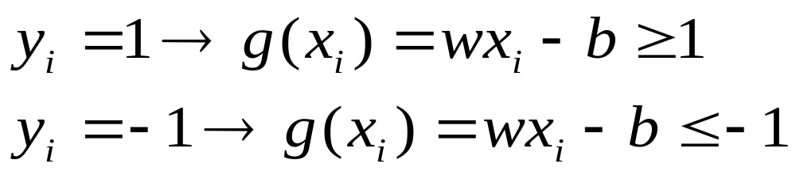
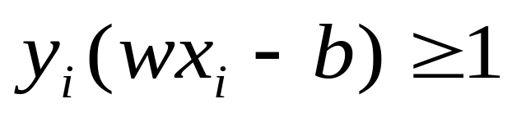
分類面方程滿足條件
對(x_{i},y_{i}) 分類面方程g(x)=wx+b應滿足
即

Slide 40
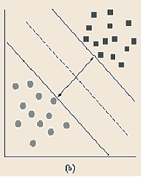
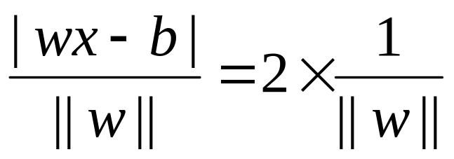
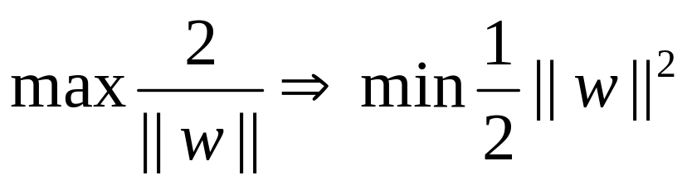
空白
空白長度
=2x樣本點到直線的距離
=2x

Slide 41
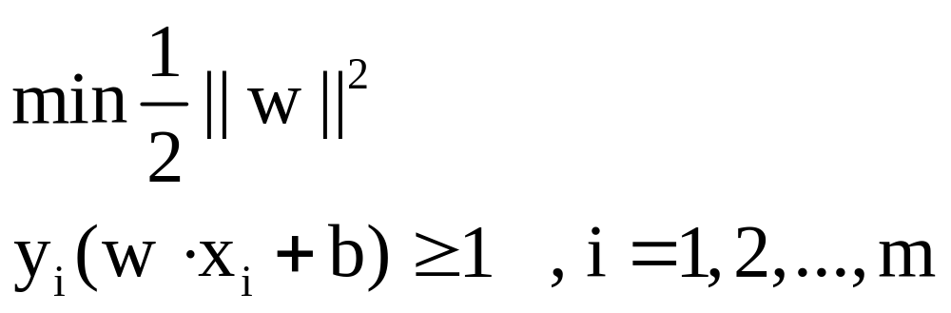
SVM
已知︰n個觀測樣本，(x₁,y₁), (x₂,y₂)…… (x_{m},y_{m})
求解︰
目標︰最優分類面 wx+b=0
註：此為Maximal Margin Classifier 問題，僅用於資料在特徵空間是線性可分割

Slide 42
Hyperplane Classifiers and
Optimal Margin Support Vector Classifier
Ref：The section 3&4 of the paper “A tutorial on nu-Support Vector Machines”

Slide 43
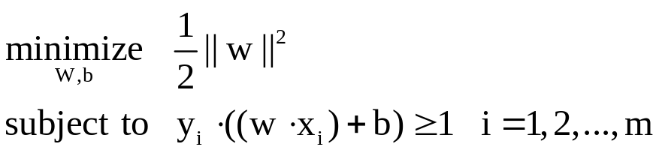
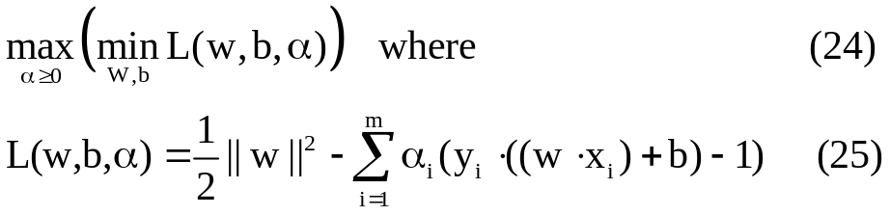
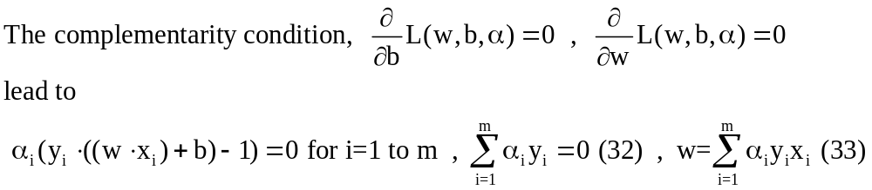
Hyperplane Classifiers
To construct the Optimal Hyperplane, one solves the following optimization problem
  Lagrangian dual
  By the KKT conditions

Slide 44
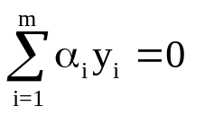
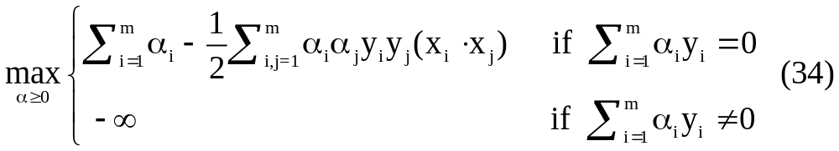
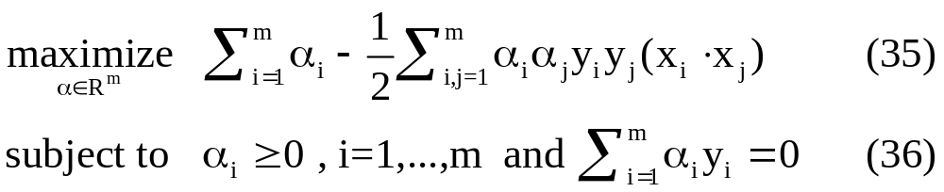
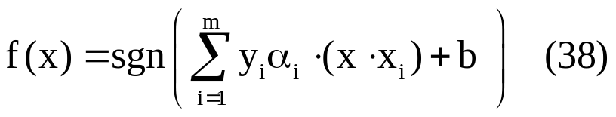
Hyperplane Classifiers
  What the means ? [ substituting (33) into (24) ]
  primal form ➔ dual form
  So the hyperplane decision function can be written as

Slide 45
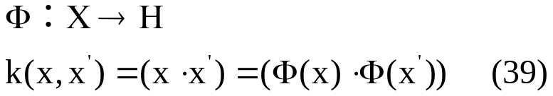
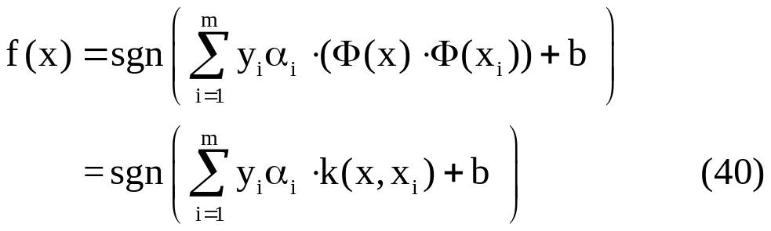
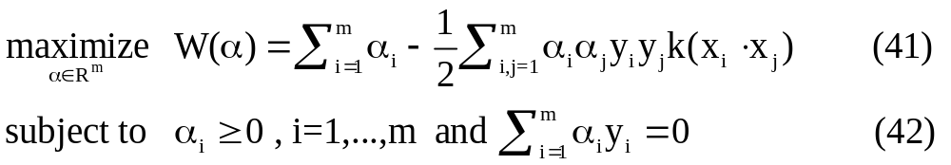
Optimal Margin Support Vector Classifiers
Linear kernel function
More general form
and the following QP

Slide 46
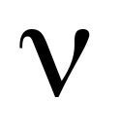
-Soft Margin
Support Vector Classifiers
Ref：The section 6 of the paper “A tutorial on nu-Support Vector Machines”

Slide 47



C-SVC
C-SVC (add a slack variables )
  Incorporating kernels, and rewriting it in terms of Lagrange multipliers

Slide 48



-SVC
C is replaced by parameter
  the lower upper bound on the number of examples that are support vectors and that lie on the wrong side of the hyperplane, respectively.

Slide 49


Slide 50

-SVC
Derive the dual form

Slide 51



-SVC
Derive the dual form [substituting (61)&(62) into L]
And the resulting decision function
Connection nu-SVC and C-SVC

Slide 52
Implement Techniques
Ref：AN INTRODUCTION TO SUPPORT VECTOR MACHINES Chap7

Slide 53
Implement Techniques
Parameter Selection
The Naïve solution
  Gradient Ascent
Chunking and Decomposition
Sequent Minimal Optimization (SMO)

Slide 54

Parameter Selection
Parameters in Kernel Function
  Kernel Alignment: a measure of similarity between a kernel and a target function .
    [Kandola 2002 Optimizing Kernel Alignment over Combinations of Kernel ]
  Cross Validation Technique (Popular)

Slide 55


Gradient Ascent
求解

Slide 56

Gradient Ascent
Simple on-line algorithm for 1-norm soft margin

Slide 57
Chunking and Decomposition
Similar to C-SVC , the difficulty is that y_{i}y_{j}k(x_{i},x_{j}) are in general not zero .Thus, for large data sets , the Hessian( second derivative) matrix of the objective function can not be stored in the computer memory
  Solution
    Traditional method：Newton or quasi Newton method
    Current ：decomposition method
Edgar Osuna(Cambridge ,MA)等人在IEEE NNSP’97發表了An Improved Training Algorithm for Support Vector Machines ,提出了SVM的分解算法

Slide 58

Chunking
Idea:
  The value of objective function is the same if zero rows and columns of the matrix Q are removed, so large QP problem breaks down into series of smaller QP problems.
Pseudo code for the general working set method

Slide 59




Osuna’s Decomposition method
Keep constant size matrix for every QP sub-problem, to allow very large size training data.
Pseudo-code:
Given training set
Select an arbitrary working set B of parameters
The set N of parameters
While KKT violated (there exists some ,such that)
select new set B by replacing any
solve optimization problem on B
return

Slide 60
Sequent Minimal Optimization (SMO)
1998 John C. Platt (Microsoft Research)
  Derived by taking the idea of the decomposition method to its extreme and optimizing a minimal subset of just two point at each iteration.
  Benefit
    doesn’t need any extra matrix storage
    doesn’t need to use numerical QP optimization step
    needs more iterations to converge, but only needs a few operations at each step, which leads to overall speed-up
  Components
    Analytic method to solve for two Lagrange parameters
    Heuristic for choosing the points

Slide 61


Sequent Minimal Optimization (SMO)
Optimize two Lagrange Multipliers

Slide 62

Sequent Minimal Optimization (SMO)
Optimize two Lagrange Multipliers

Slide 63

Sequent Minimal Optimization (SMO)
Update After A Successful Optimization Step

Slide 64
Summary for chunking and decomposition
 | need QP module? | size for each iteration | iteration unit
Chunking | Y | arbitrary | training sample
Osuna’s decomposition | Y | arbitrary | parameter α
SMO | N | 2 | parameter α

Slide 65
Implementation of -SV Classifiers
Ref：The section 7 of the paper “A tutorial on nu-Support Vector Machines”

Slide 66

ν-SVC
Dual form
Proves that for any given ν, there
Is at least an optimal solution which
satisfies e^{T}α=ν [C.-C. Chang 2001]

Slide 67

ν-SVC
Decomposition method algorithm

Slide 68

ν-SVC
SMO-type Implementation
  (79) and (80) can be rewritten as

Slide 69
Tools
SVM implementation
  Royal Holloway, GMD-FIRST, ATT
  SVM^{light} (C) by Thorsten Joachims
  libsvm (C++/Java/Python) by Chih-Chung Chang and Chih-Jen Lin
  Torch (C++) by Ronan Collobert
  Weka (Java) at University of Waikato
  http://www.kernel-machines.org/
Optimization package:
  MINOS (Licensed Software) by Bruce Murtagh and Michael Saunders
  LOQO by Robert Vanderbei
  MATLAB package

Slide 70
Conclusion
Kernels provide an elegant framework for studying three fundamental issues of machine learning
  Similarity measures—the kernel can be viewed as a (nonlinear) similarity measure, and should ideally incorporate prior knowledge about the problem at hand
  Data representation — as described above, kernels induce representations of the data in a linear space
  Function class — due to the representer theorem, the kernel implicitly also determines the function class which is used for learning.

Slide 71
The End

